Slide 1
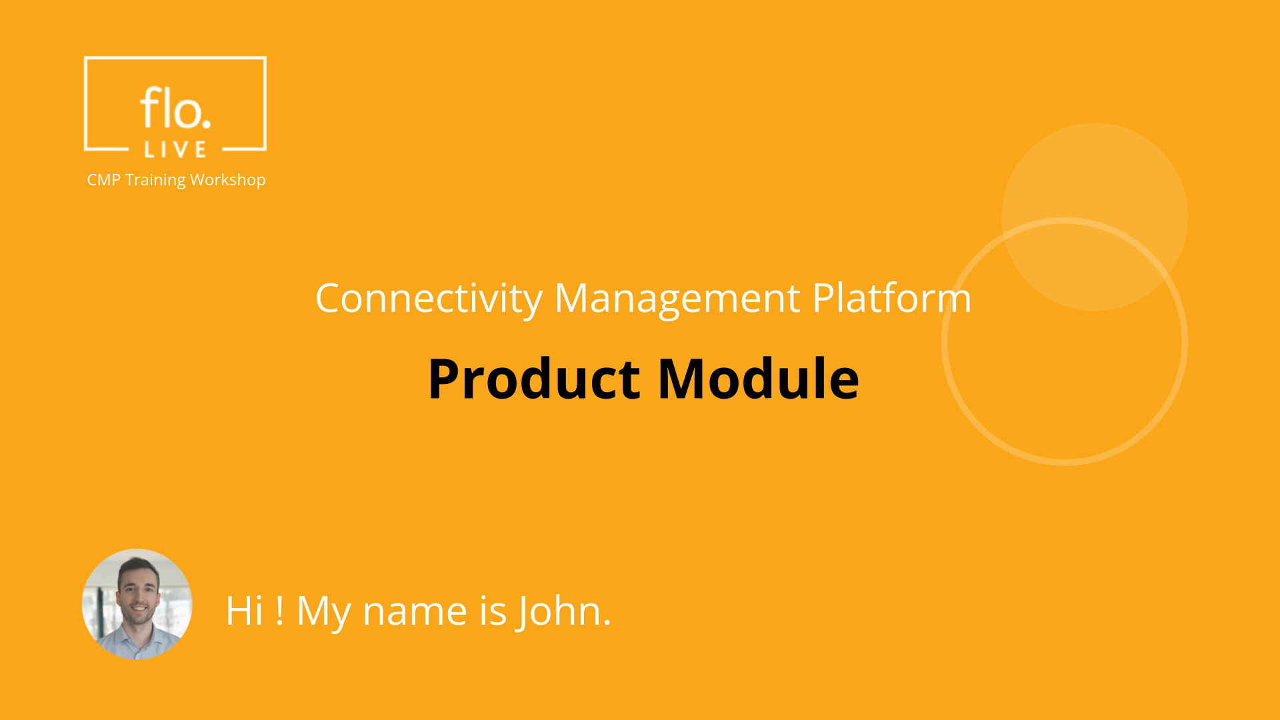
Notes:
Hi, My name is John and welcome to the CMP Training Workshop

Slide 2
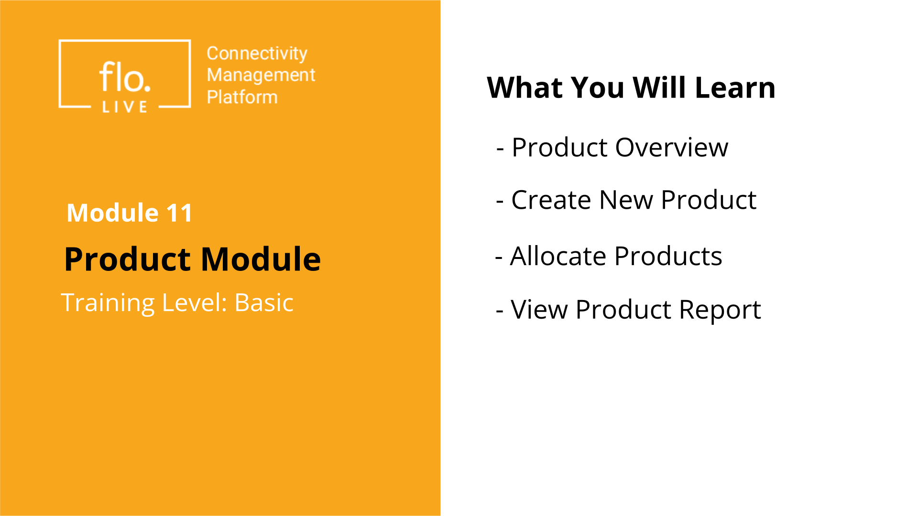
Notes:
In this tutorial, we will explore how to charge customers a recurring fee for the use of a product or service. You will learn how to create a new product, then we will discover how to allocate products to your sub-accounts, and then find out how to view a report listing the products allocated to your customers.

Slide 3
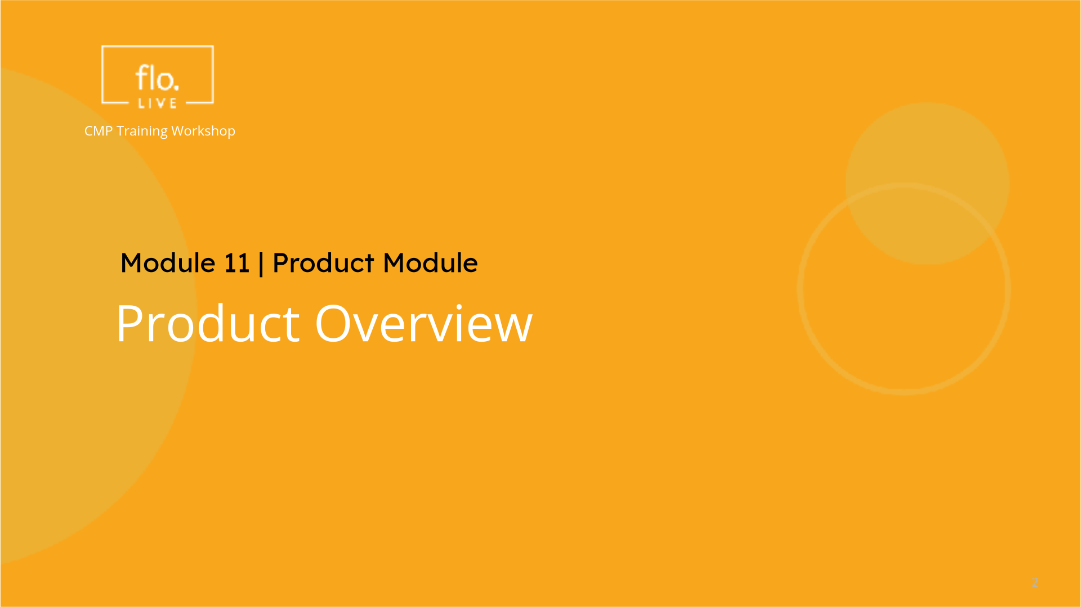
Notes:
We begin this tutorial with a quick tour of the Product module.

Slide 4
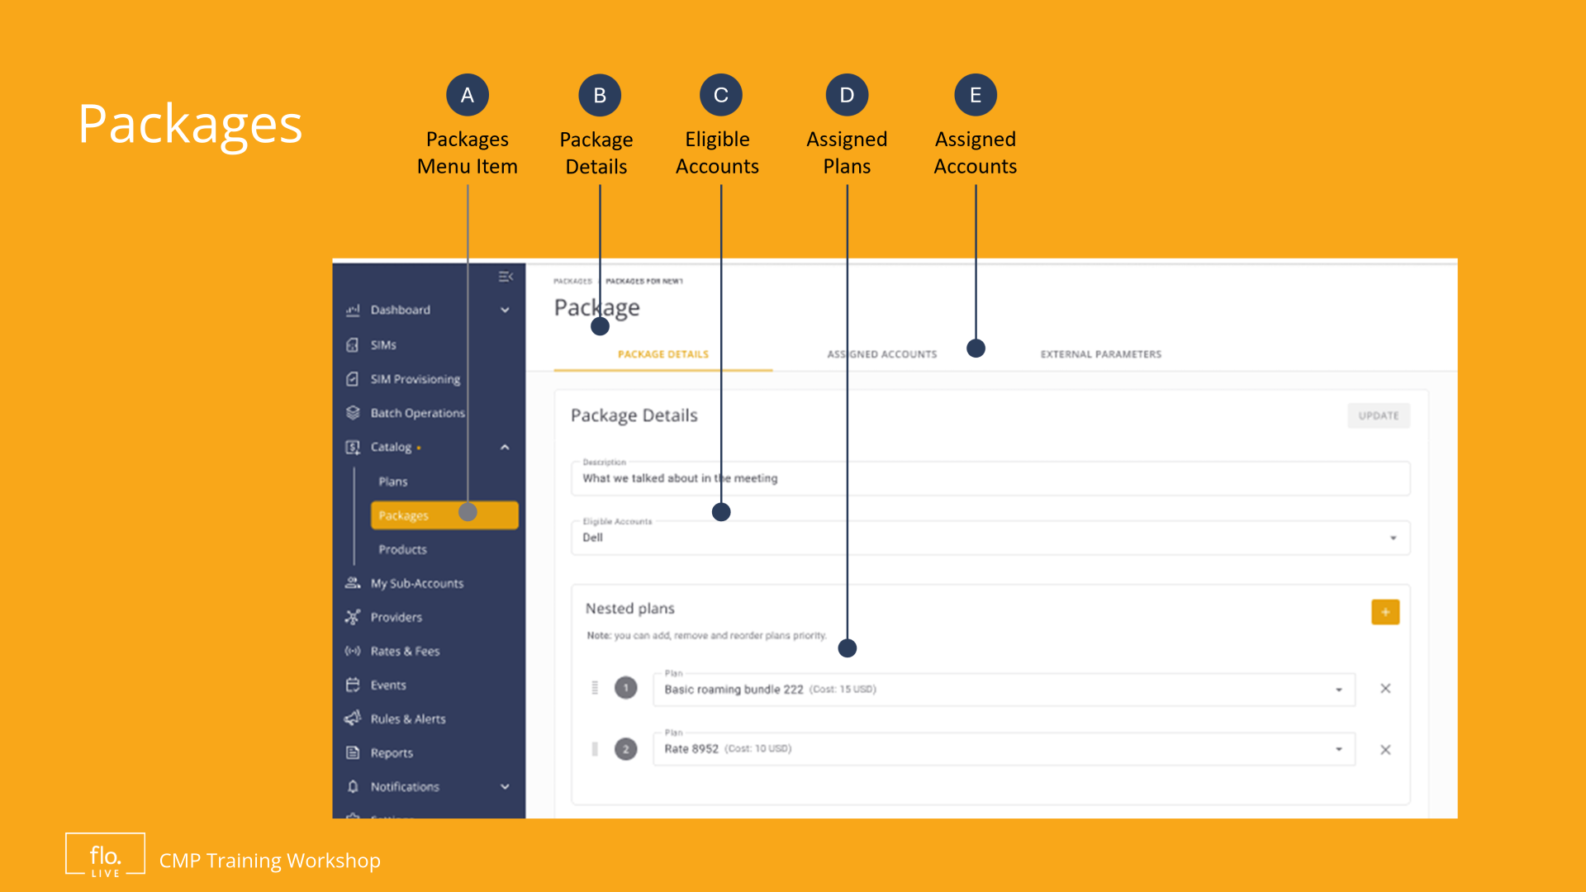
Notes:
A Product or service enables you to assign a 'recurring charge or fee' to your sub-accounts. Example products may include: APN and VPN services; CDR stream services white-labelling or any other type of chargeable service. Parent accounts can define one or more product fees for any of their sub-accounts to ensure they are charged appropriately for the services they consume./

Slide 5
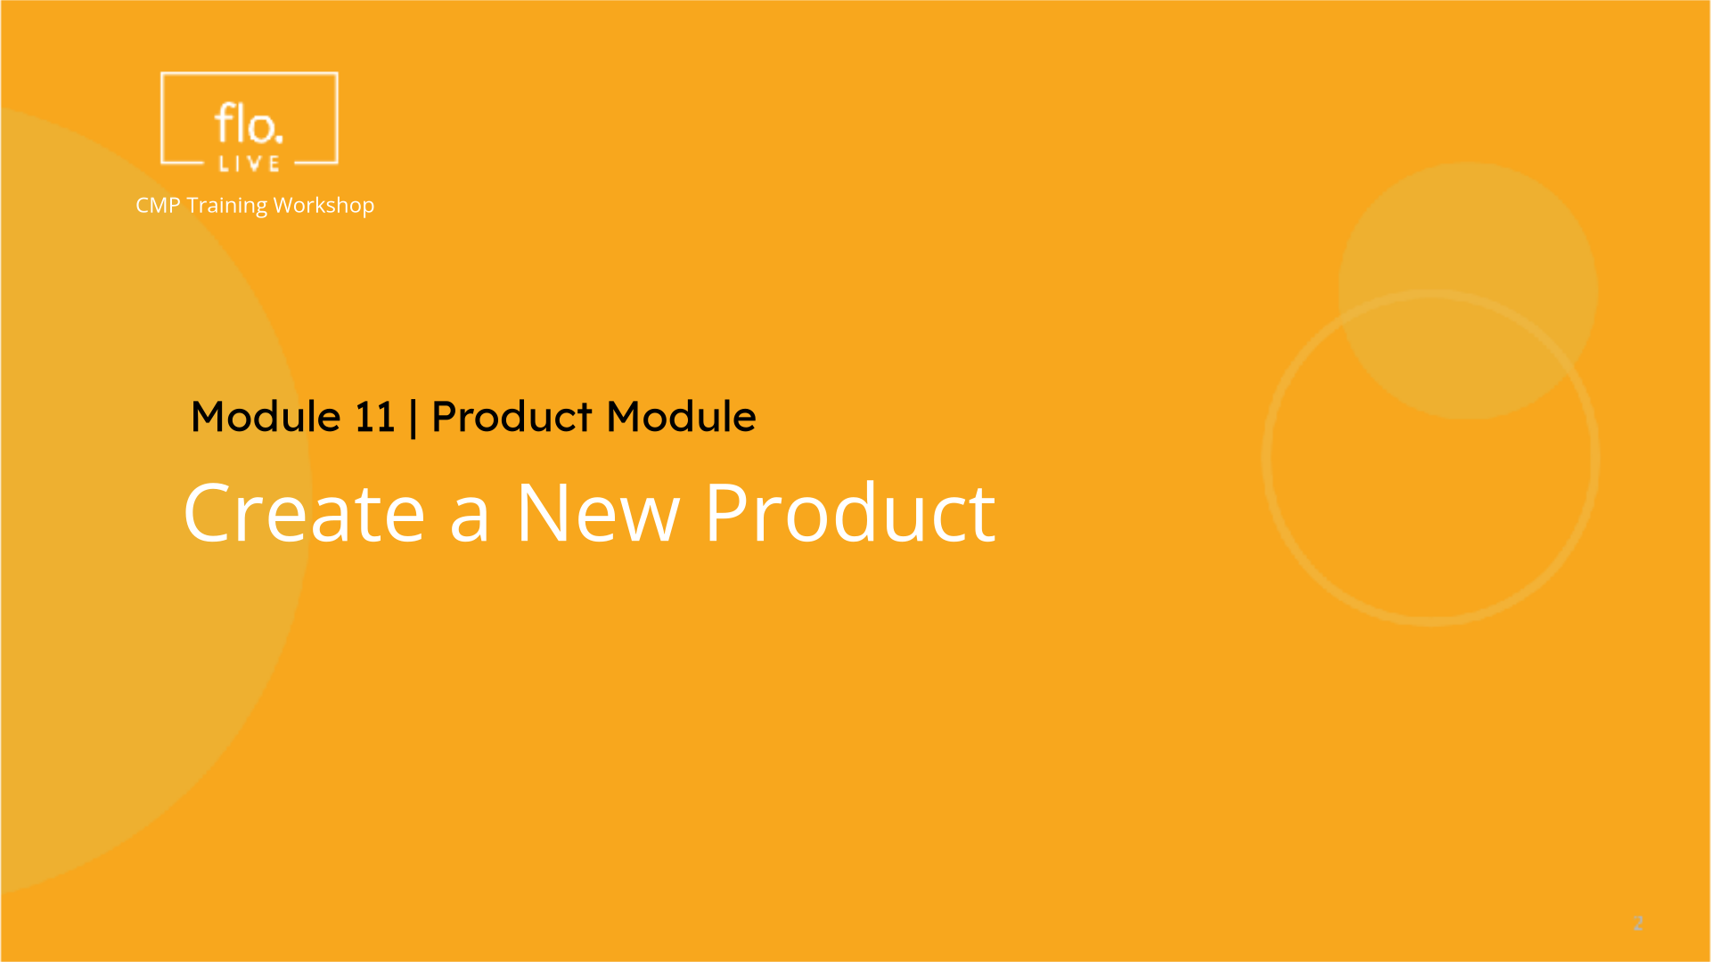
Notes:
Lets learn how to create a new product in the CMP portal.

Slide 6
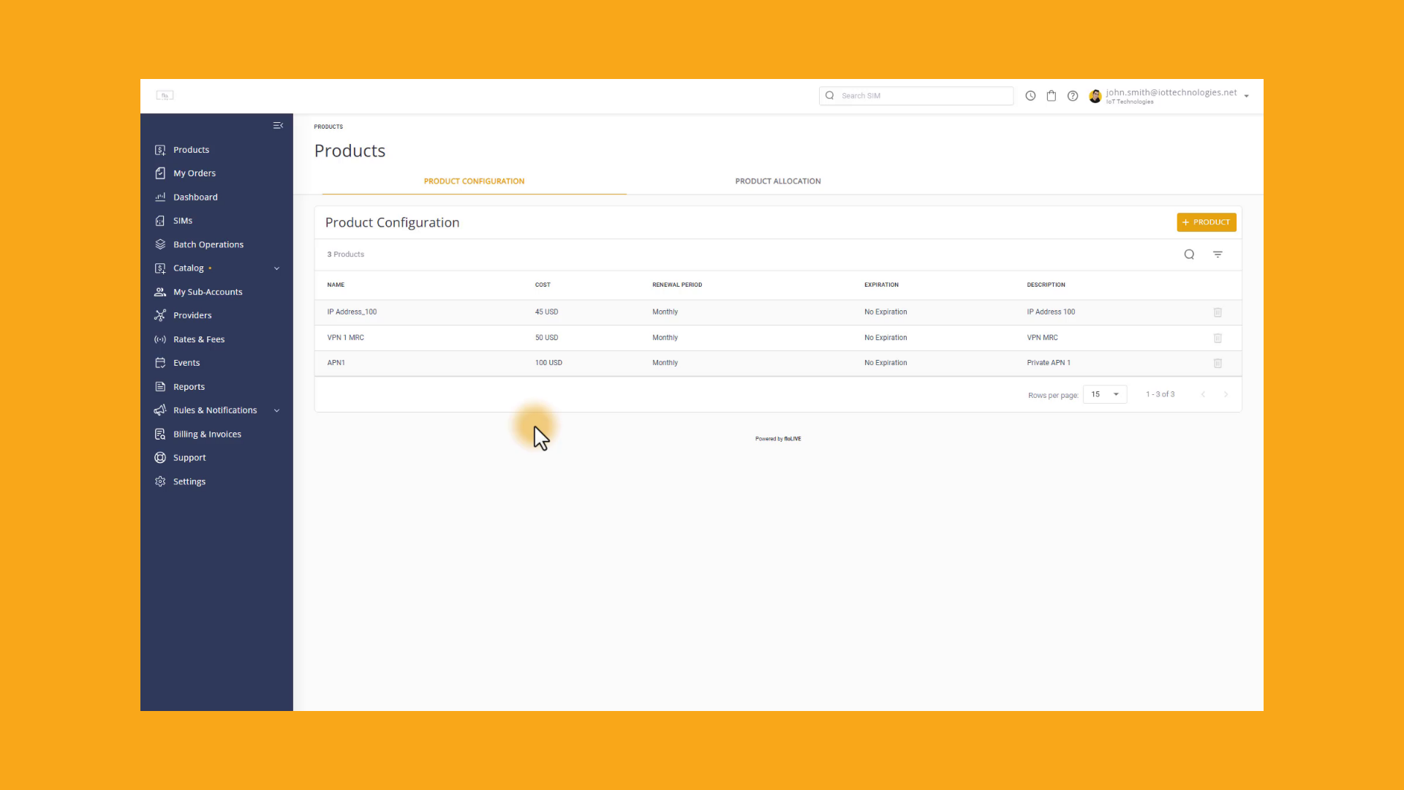
Notes:
Navigate to the Category group on the sidebar and click the Product menu item to display a list of defined products. You can click on a product to display the product details. Lets go back to the main page to create a new Product. Click the Add Product button to display the Create New Product dialog box. Enter a name in the Product Name field. Add the Product Cost value. and then Specify the Currency from the list of options. It is recommended that you add a short description to provide additional information about this product.
Select an appropriate Renewal time-frame and then set the day of renewal.
The Expiration options enable you to determine when the product charges will be terminated. Select the no expiration option or select a specific date to determine when the product expires.
Finally,click Create to display the product in the product table.

Slide 7
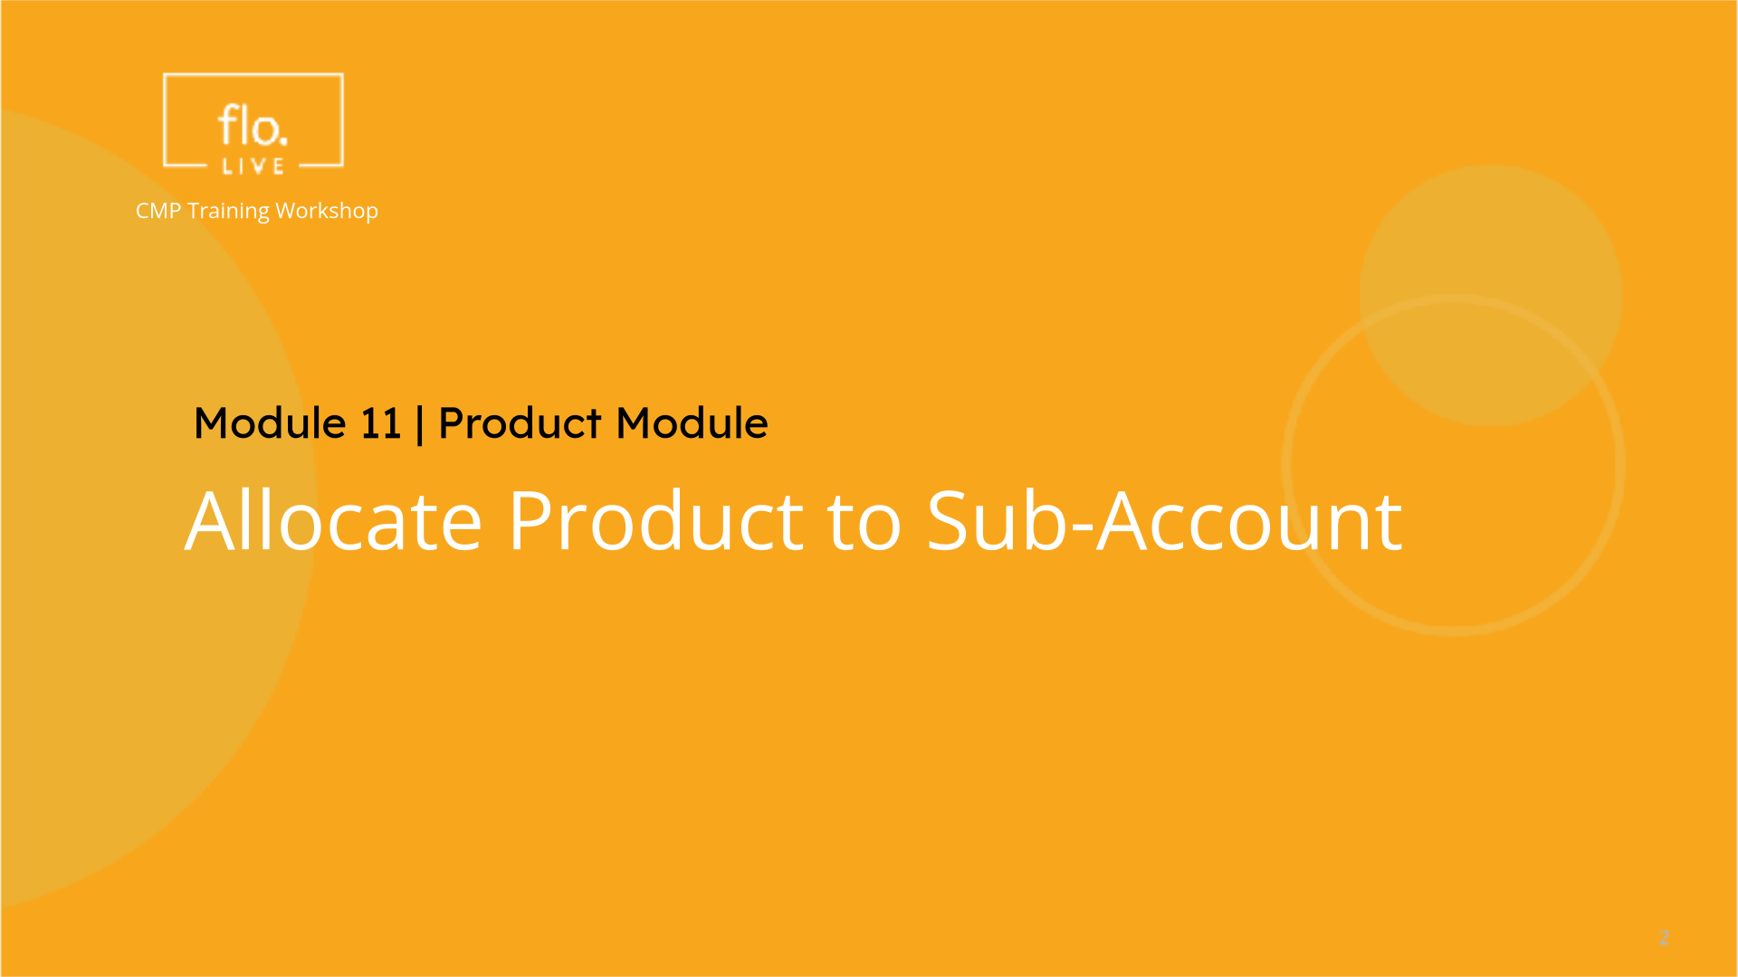
Notes:
Now that you know how to create a product, lets allocate this new product to one or more of your sub-accounts.

Slide 8
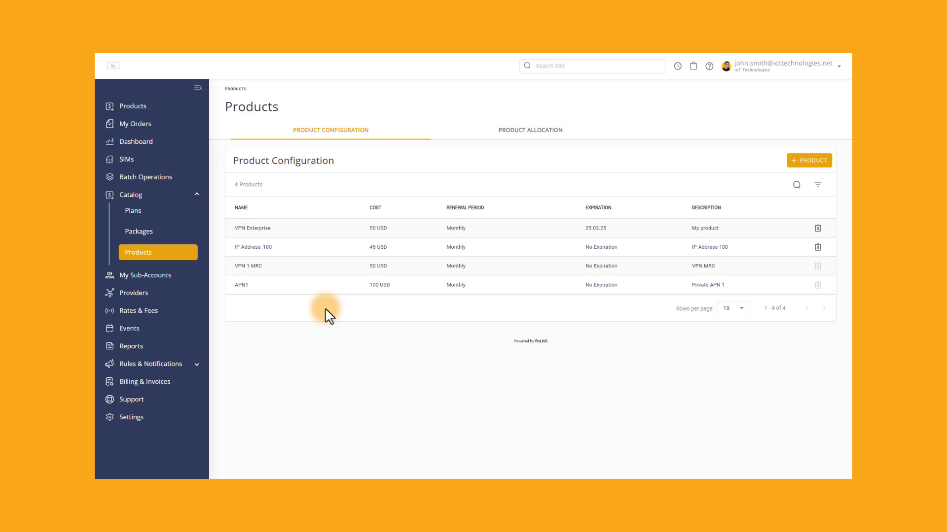
Notes:
Navigate to the sidebar and click the Products menu item. Select the Product Allocation tab and then select the Allocated to Sub Accounts Tab. Click the Allocation button to display the allocate product settings. Select one or more sub-accounts and then allocate one or more products for the selected accounts. Finally, click Create to allocate the products to your sub-accounts. The selected sub-accounts will now be charged for the allocated products.

Slide 9
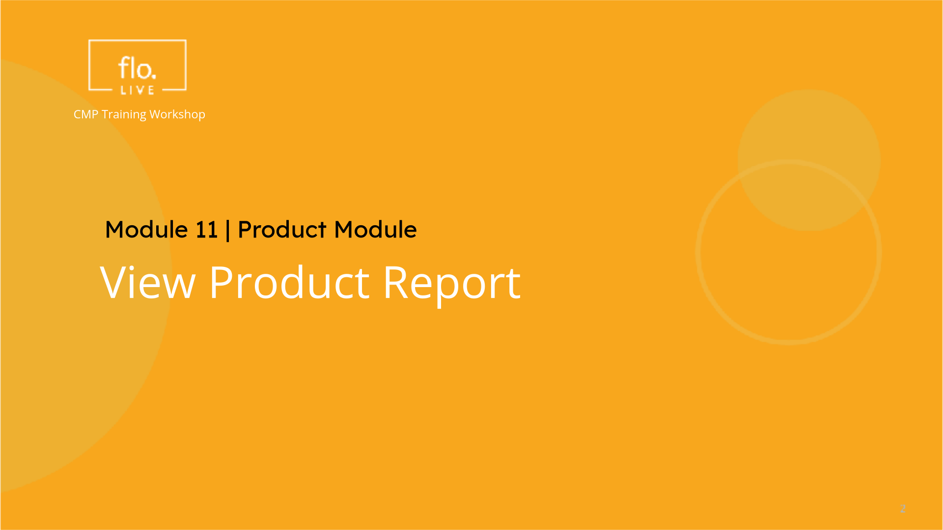
Notes:
To complete this tutorial we will examine how to view a report containing details of the products allocated to your sub accounts.

Slide 10
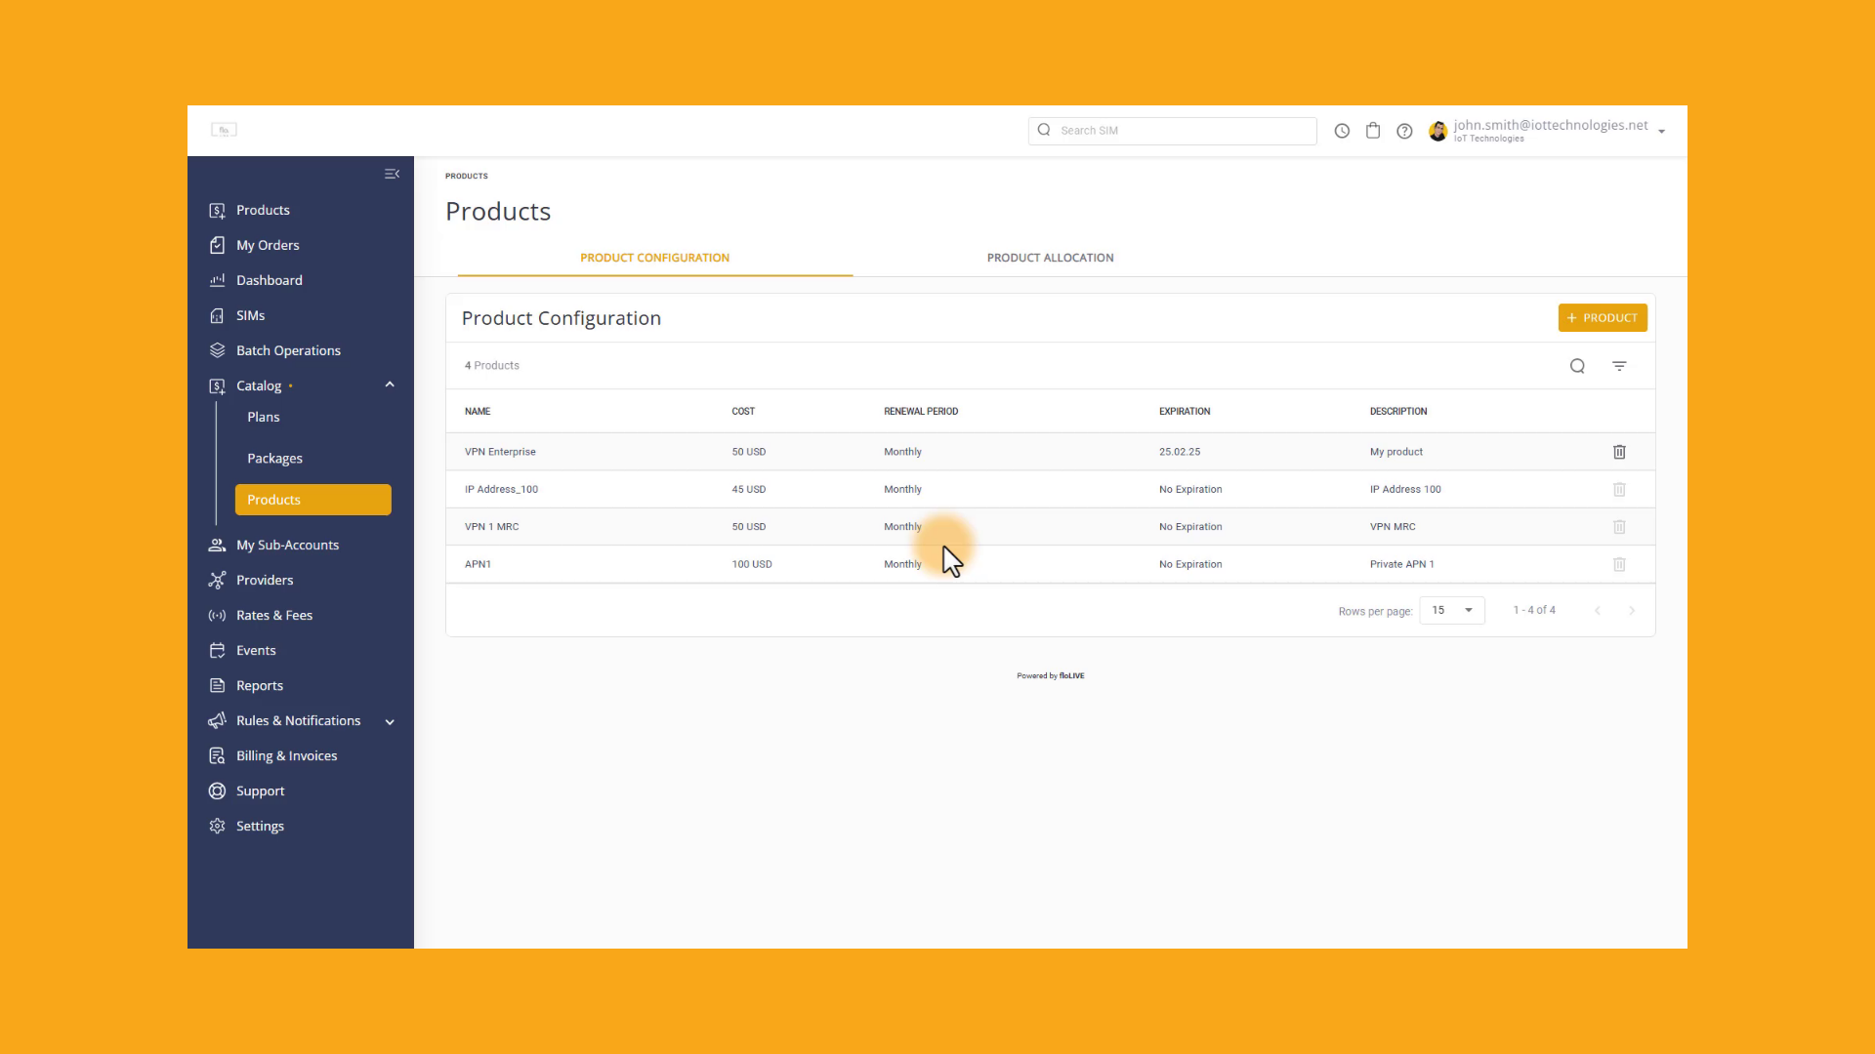
Notes:
Select Reports from the sidebar menu. . Go to the Report Type list and Select Account Products . Now select the sub-accounts you want to display and then select a timeframe for the report. Finally click Execute to display the products allocated to the selected accounts. The report contains a list of sub-accounts with the allocated products.

Slide 11
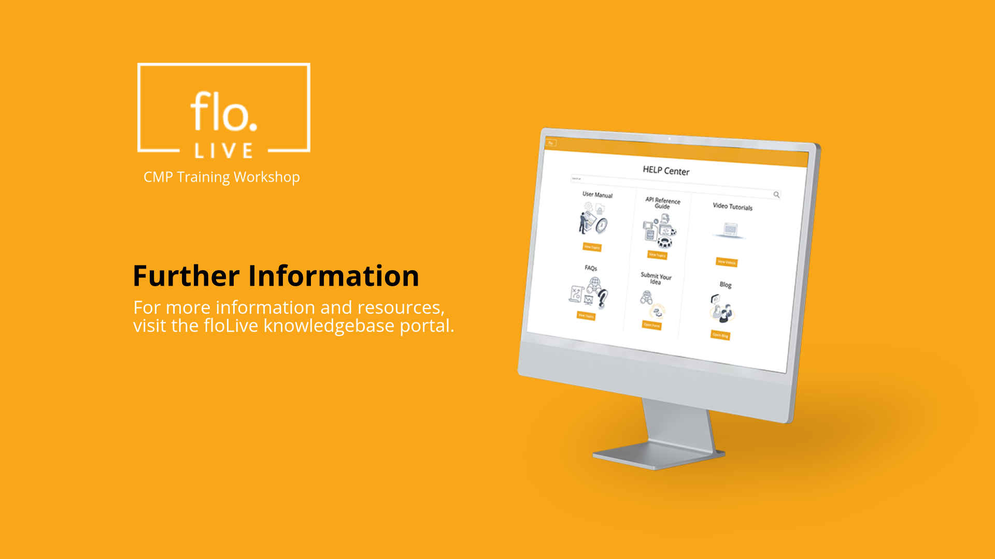
Notes:
Thank you for watching this video tutorial. For more information about the CMP system, make sure you visit our Knowledge-base that is accessible directly from the CMP Portal.

